Slide 1
Sonata Query-driven Streaming Network Telemetry
Arpit Gupta
Princeton University
Rob Harrison, Marco Canini, Nick Feamster,
Jennifer Rexford, Walter Willinger
Presented by Kai Fang

Slide 2
Network Management
Outages
Google
Level3
Cyberattacks
Cogent
Detect network events in real time
Network Operator
Umich
Congestion
Notes:
A natural problem to begin with would be, why do we need telemetry in the first place? Well, telemetry can tell you about the status of the Internet, and it is critical to know when something bad happens. For example, there could be an outage between Google and Level 3, or there could be a congestion between Google and Umich, which is unlikely, and there could even be attackers trying to initiate DDoS attack to Google from Umich, which is far more unlikely. Anyway, if we can detect network events in real time, it would really help in so many cases to prevent data and intellectual property loss.

Slide 3
Network Monitoring Requirements
DNS
Src: DNS
Dst: Victim
Receive
DNS responses from many distinct sources
Src: Victim
Dst: DNS
DNS
👺
Src: DNS
Dst: Victim
Flexible network monitoring is desired
Traffic
Metrics
Src: Victim
Dst: DNS
jitter
distinct hosts
volume
delay
loss
…
address
protocol
payload
device
location
…
Attacker
😵
Victim
Notes:
Obviously, Internet telemetry is not trivial. Here is an attack, called DNS reflection attack, where the attacker send floods of DNS request to DNS servers with identical spoofed source IP, and the victim will be bombarded by DNS responses sent back by the DNS servers. If we have telemetry, we can definitely find some clues by just looking at the traffic, and if we know this is happening, we can take some actions to stop it, or even prevent it from happening. However, there are so many aspects of the traffic that we can look at, so it is also important to pick out the right metric that we want to use when we do telemetry here.

Slide 4


Network Monitoring with Sonata
Performance Diag..
Malware Detection
Flexibility
Fault Localization
DDoS Detection
Abstractions
System
Sonata
Algorithms
Scalability
Notes:
we want our telemetry system to have a good flexibility, so we can do a lot with it, like xxx
We also want our system to have a good scalability, so we can deploy it to a large network.
Sonata is a telemetry that achieves both flexibility and scalability, by providing good abstractions in the framework, and also a good algorithm to split work on switches and stream processors.

Slide 5
Building Sonata is Challenging
Programming abstractions
How to let network operators express queries for a wide-range of monitoring tasks?
Scalability
How to execute multiple queries for high-volume traffic in real time?

Slide 6
Building Sonata is Challenging
Programming abstractions
How to let network operators express queries for a wide-range of monitoring tasks?
Scalability
How to execute multiple queries for high-volume traffic in real time?

Slide 7
Packet as Tuple
Packet
traversed path, queue size, number of bytes, …
Metadata
Header
source/ destination address, protocol, ports, …
Payload
Treat packet as a tuple
Packet = (path, qsize, nbytes,…
sIP, dIP, proto, sPort, dPort, …
payload)
Notes:
Sonata treats packet as tuple. It simply unpack the packet and take all the fields inside the packet as a part of tuple.

Slide 8
Monitoring Tasks as Dataflow Queries
Detecting DNS Reflection Attack
Identify if DNS response messages from unique DNS servers to a single host exceeds a threshold (Th)
victimIPs = pktStream
.filter(p => p.udp.sport == 53)
.map(p => (p.dstIP, p.srcIP))
.distinct()
.map((dstIP, srcIP) => (dstIP, 1))
.reduce(keys=(dstIP,), sum)
.filter((dstIP, count) => count > Th)
DNS Responses
from Unique DNS Servers
to a Single Host
exceeds a Threshold
Notes:
When we want to perform some monitoring tasks, we can then implement them as dataflow queries, and apply it to packets.
In sonata, for example, to detect a DNS reflection attack we want to count the number of all the DNS responses that are being sent to the same IP address.
The code will look like this:

Slide 9
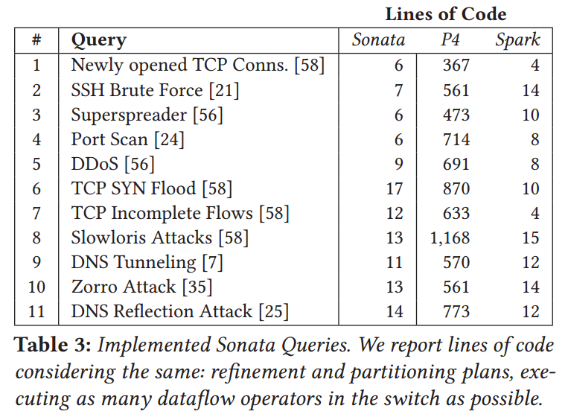
Monitoring Tasks as Dataflow Queries
Express wide range of network monitoring tasks in fewer than 20 lines of code
Notes:
With this model, we can expressed wide range of network monitoring tasks in fewer than 20 lines of code, which is very ideal and a good proof of flexibility of the system.

Slide 10
Building Sonata is Challenging
Programming abstractions
How to let network operators express queries for a wide-range of monitoring tasks?
Scalability
How to execute multiple queries for high-volume traffic in real time?

Slide 11
Where to Execute Monitoring Queries?
CPUs
Switches
Match | Headers + Payload
Actions | Any
State | O(Gb)
Speed | O(μs)
Headers++
add, subtract, bit operations
O(Mb)
O(ns)
Gigascope [SIGMOD’03]
NetQRE [SIGCOMM’17]
Univmon [SIGCOMM’16]
Marple [SIGCOMM’17]
Notes:
Previous solutions either use CPUs to execute monitoring queries, or use switches to do it. CPUs have stronger computational power, which means it can handle more complicated tasks and extract more information for telemetry, but they are slow. Solutions using switches are fast, but they have more limitation on what they can do with the traffic.
To do better than any of these solutions, sonata is designed to use both CPUs and switches to execute monitoring queries.

Slide 12
Where to Execute Monitoring Queries?
Can we use both switches and CPUs?

Slide 13
PISA* Processing Model
Programmable Parser
Persistent State
Programmable Deparser
Memory
ALU
ip.src=1.1.1.1
ip.dst=2.2.2.2
...
Stages
Packet Header Vector
*RMT [SIGCOMM’13]
Notes:
Here is the classical PIAS processing model, and all the queries are converted to DAGs and then sent to the data plane.

Slide 14
Mapping Dataflow to Data plane
 | Dataflow | Data plane
Model | Pipeline | Pipeline
Processing Unit | Operators | Match-Action Tables
Structured Data | Tuples | Packets
Which dataflow operators can be compiled to match-action tables?
Notes:
In the PISA Processing Model, we need to map dataflow to data plane, and operators in dataflow need to be mapped to match-action tables, and tuple will be mapped to packets. We would like to know, which dataflow operators can be compiled to match-action tables?

Slide 15
Compiling Individual Operators
Stream of elements
Elements satisfying
predicate (p)
filter(p)
Input
Output
pvictimIPs = pktStream
.filter(p => p.udp.sport == 53)
.map(p => (p.dstIP, p.srcIP))
.distinct()
.map((dstIP, srcIP) => (dstIP, 1))
.reduce(keys=(dstIP,), sum)
.filter((dstIP, count) => count > Th)
Match | Action
p
udp.sport == 53
1
2
3
4
5
6
7
Notes:
Here are two examples. The filter operator do nothing to the data, but have certain matching rules applied to them, so not all packets will be matched.

Slide 16
Compiling Individual Operators
Stream of elements
Result of applying
function f over all elements
reduce(f)
Input
Memory
Output
pvictimIPs = pktStream
.filter(p => p.udp.sport == 53)
.map(p => (p.dstIP, p.srcIP))
.distinct()
.map((dstIP, srcIP) => (dstIP, 1))
.reduce(keys=(dstIP,), sum)
.filter((dstIP, count) => count > Th)
Match | Action
* | idx = hash(m.dstIP)
1
2
3
4
5
6
7
Match | Action
* | stateful[idx] += 1
Notes:
Reduce operator on the other hand, does not have a predicate to match, but instead applying function f over all elements.

Slide 17
Compiling a Query
Programmable Parser
State
Programmable Deparser
Filter Map
D1
D2
Map
R1
R2
Filter
Stages
Notes:
In this way, a query can be compiled to a series of match-action tables in the data plane.

Slide 18
Query Partitioning Decisions
pvictimIPs = pktStream
.filter(p => p.udp.sport == 53)
.map(p => (p.dstIP, p.srcIP))
.distinct()
.map((dstIP, srcIP) => (dstIP, 1))
.reduce(keys=(dstIP,), sum)
.filter((dstIP, count) => count > Th)
pvictimIPs = pktStream
.filter(p => p.udp.sport == 53)
.map(p => (p.dstIP, p.srcIP))
.distinct()
.map((dstIP, srcIP) => (dstIP, 1))
.reduce(keys=(dstIP,), sum)
.filter((dstIP, count) => count > Th)
pvictimIPs = pktStream
.filter(p => p.udp.sport == 53)
.map(p => (p.dstIP, p.srcIP))
.distinct()
.map((dstIP, srcIP) => (dstIP, 1))
.reduce(keys=(dstIP,), sum)
.filter((dstIP, count) => count > Th)
pvictimIPs = pktStream
.filter(p => p.udp.sport == 53)
.map(p => (p.dstIP, p.srcIP))
.distinct()
.map((dstIP, srcIP) => (dstIP, 1))
.reduce(keys=(dstIP,), sum)
.filter((dstIP, count) => count > Th)
Resources?
Query Planner
Reduce Load?
Tuples
Notes:
However, the system still need to decide whether it wants the switches to execute the query, or the stream processors to do it. As the packets are moving through the switches, they need to be converted to tuples and then sent to stream processors. On the one hand, since switches have only limited resources, as we have seen before, it cannot handle too much work. On the other hand, we also want to reduce the load of stream processors to make this system fast and more scalable. Therefore, we need to figure out an optimal way to partition the queries to switches or CPUs.

Slide 19
Query Partitioning ILP
Constraints
Programmable Parser
Persistent State
Programmable Deparser
PHV Size
Memory
ALU
Number of
Actions
Stateful Memory
Total Stages
Packet Header Vector
Stages
Goal: Minimize tuples sent to stream processor
Notes:
Sonata models this problem as an Integer Linear Programming problem. Its goal is to minimize tuples sent to stream processor. We want as much as possible work to be done by the switches before we go back to use slow but powerful stream processors.

Slide 20
How Effective is Query Partitioning?
O(1 B)
Log Scale
8 Tasks, 100 Gbps Workload
Notes:
From their experiment, the author found that with partitioning, the workload on stream processors is reduced by one order of magnitude, which is not very ideal, as the workload is still pretty high.

Slide 21
How Effective is Query Partitioning?
O(1 B)
O(100 M)
Log Scale
Only one order of magnitude reduction
8 Tasks, 100 Gbps Workload

Slide 22
Query Partitioning Limitations
distinct
reduce
Filter Map
D1
D2
Map
R1
R2
Filter
How can we reduce the
memory footprint of stateful operators?
Notes:
One of the limitations of partitioning is that stateful operators are still using huge chunk of memory which added a lot workload to the stream processors.

Slide 23
Observations: Nature of Monitoring Tasks
DNS Reflection Attack Victims
Most monitoring tasks are looking for needles in a haystack
All Hosts
Notes:
The authors made an observation, that to find the DNS Reflection attack victims are just like finding needs in a haystack. There are too much useless information to be filtered out.

Slide 24
Observations: Possible to Reduce Memory Footprint
Detecting DNS Reflection Attack
Only consider first 8 bits
victim = pktStream
.map(dIP => dIP/8)
.filter(p => p.udp.sPort == 53)
.map(p => (p.dIP, p.sIP))
.distinct()
…
Queries at coarser levels have smaller memory footprint
Notes:
Therefore, it would be helpful if we firstly narrow down the searching range to create more but smaller batches of queries to execute. For example, we can first ignore last 8 bits of the IP addres.

Slide 25
Observations: Possible to Preserve Query Accuracy
Detecting DNS Reflection Attack
victim = pktStream
.map(dIP => dIP/8)
.filter(p => p.udp.sPort == 53)
.map(p => (p.dIP, p.sIP))
.distinct()
…
Hierarchical packet field
Query accuracy is preserved if refined with hierarchical packet fields
Notes:
Note that, if we refine the queries with hierarchical packet fields, the query accuracy will be preserved.

Slide 26
Iterative Query Refinement
map(dIP=>dIP/8)
Packet Stream
Window
Map
Filter Map
D1
D2
Map
R1
R2
Filter
t+W
PISA Target
First, execute query at coarser level
Notes:
When we have a better idea of the first 24-bits of possible victims, we can then just focus on those Ips and do another round of filtering and mapreduce to find out the real victims.

Slide 27
Iterative Query Refinement
Smaller
memory footprint
Detection
Delay
Smaller memory footprint at
the cost of additional detection delay
Map
Filter Map
D1
D2
Map
R1
R2
Filter
Filtered
Packet Stream
t+2W
Filter
Filter Map
D1
D2
Map
R1
R2
Filter
PISA Target
Then, execute query at finer level(s)
Notes:
In this way, those stateful operators will use less memory and thus send much fewer tuples to the stream processers. However, since we need to run the packets through the data plane twice, we have an additional detection delay here. We definitely can do multiple refinements to further reduce memory footprint, but that means we need to wait longer, and we need to find a good balance on memory usage and overhead from extra refinements.

Slide 28
Query Planning Problem
Goal
Minimize tuples sent to the stream processor
Given
Queries, packet traces
Determine
Which packet field to use for iterative refinement?
What levels to use for iterative refinement?
What’s the partitioning plan for each refined query?
Augment partitioning ILP to compute both refinement and partitioning plans
Notes:
Hence, the authors proposed to augment partitioning ILP to compute both refinement and partitioning plans, so the overall performance of the system will be optimized,

Slide 29
Sonata’s Performance
O(1 B)
O(100 M)
Log Scale
O(100 K)
Up to 4 orders of magnitude reduction
8 Tasks, 100 Gbps Workload
Notes:
With partitioning and query refinements, Sonata achieves up to 4 orders of magnitude reduction on workload of the stream processors.

Slide 30
Summary
http://sonata.cs.princeton.edu
Key Takeaways
Flexible
Dataflow queries over packet tuples
Fewer than 20 lines of code
Scalable
Query refinement and partitioning algorithms
4 orders of magnitude workload reduction
Future Directions
Monitor network-wide events – observing at multiple locations
https://github.com/sonata-princeton

Slide 31
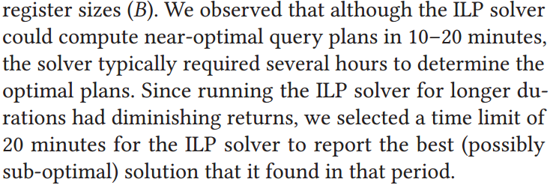
Limitations & Weaknesses
Slow solver for ILP, which will be used for each batch of queries.
Could be sensitive to input value – more robustness.
Only works on single switch
Not enough evaluation & application

